Slide 1
Cyberprotect: A Simulation Game
Presented by:
Lorraine Lee
UNC Wilmington

Slide 2
Active Learning Exercise
Paper: Hayes, O’Bryan, and Vician 2019. “Mitigating Cyberattacks: An Active Learning Instructional Resource,” Journal of Forensic and Investigative Accounting, 11:1, 221-225.
Paper also presented at the 2017 AIS Midyear Meeting
Students learn about cyberattacks, mitigation strategies, professional regulations
Students assume the role of a systems administrator purchasing tools and experimenting to defend against possible random cyberattacks

Slide 3
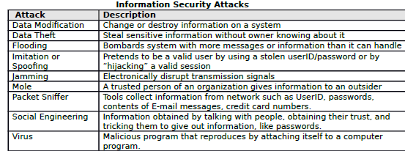
CyberProtect Simulation
CyperProtect Simulation available:
http://iatraining.disa.mil/eta/cyber-protect/launchpage.htm
Fun simulation for students
Goal: 75% Readiness Rating
Issue: Simulation may not always be available at the external site
Exercise provides an excellent introduction to information security threats

Slide 4
CyberProtect: Protecting the Network

Slide 5
Selecting the Tools

Slide 6
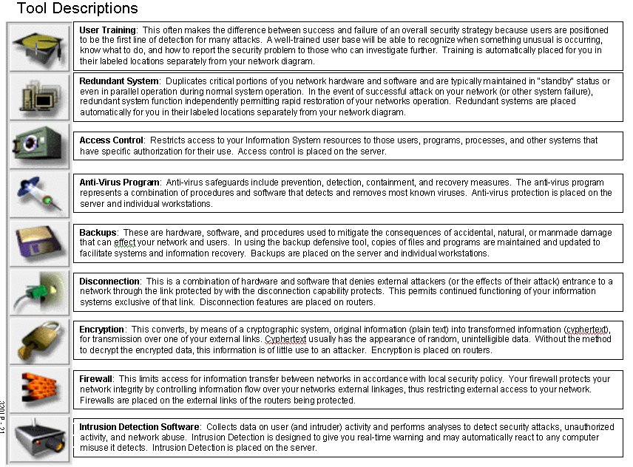
Mitigation of Threats through Tools

Slide 7
Purchasing the Tools

Slide 8
Deploying the Tools

Slide 9
Cyber Attack #1

Slide 10
Cyber Attack #1

Slide 11
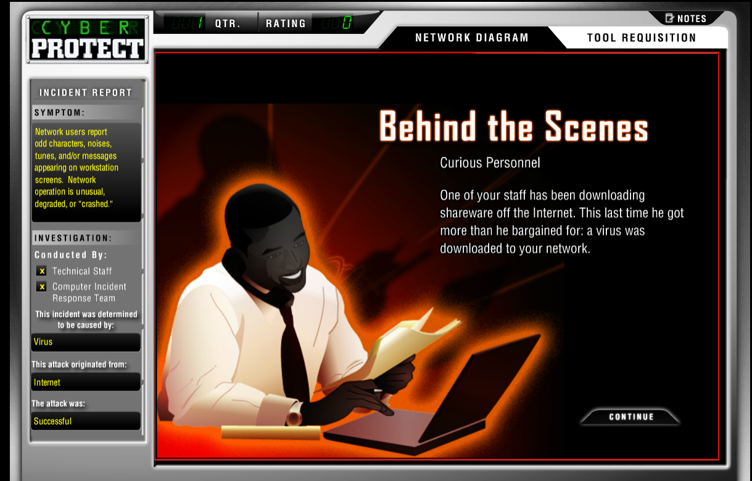
Attack Details

Slide 12
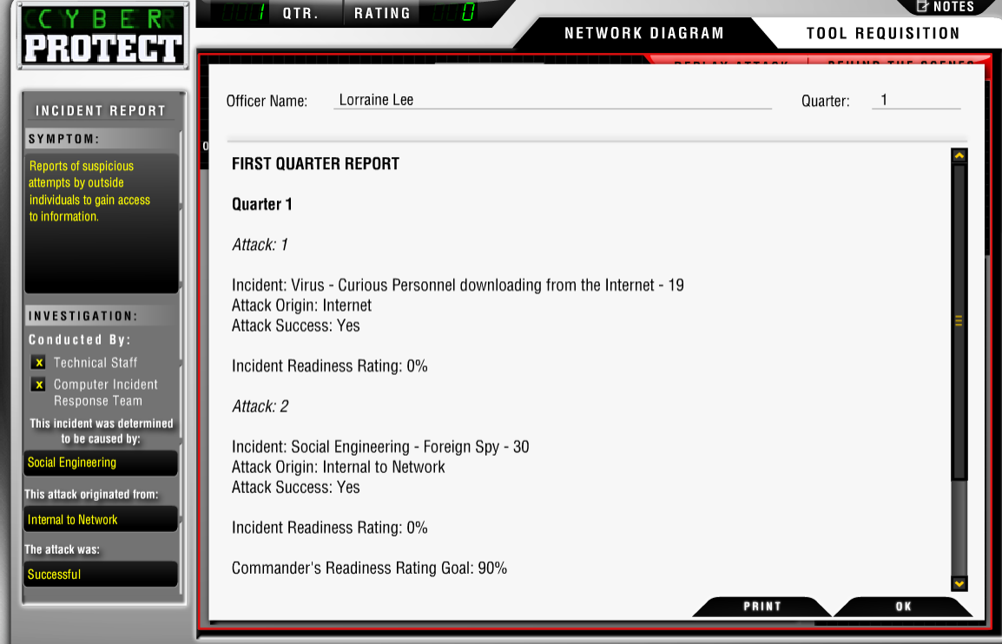
1st Quarter Report

Slide 13
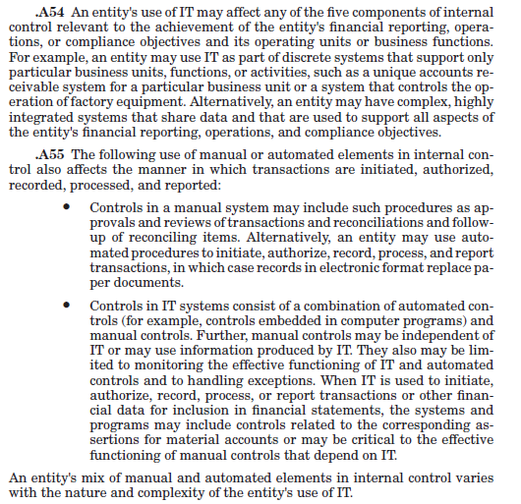
Class Discussion: IT and Internal Control
Focus specifically on the standards related more directly to information technology
Example: AU-C Section 315: Understanding the Entity and its Environment and Assessing the Risk of Material Misstatement

Slide 14
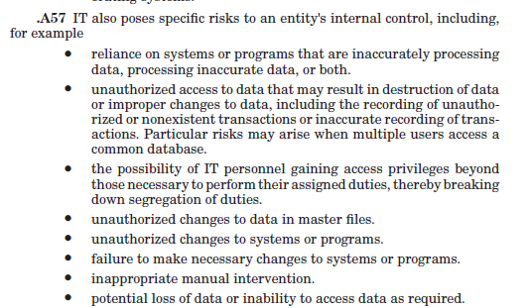
AU-C Section 315: IT and Internal Control

Slide 15
General IT Controls

Slide 16
Summary
CyberProtect is a fun, interesting simulation available to AIS educators in a format that can be easily incorporated into the classroom.
Instructors can focus on standards related to information security, IT controls, etc.

